Slide 1
Do something in your Heart
Linux Kernel Module Development Tutorial

Slide 2
My Heart?
On Linux, the heart is the kernel. Only Linux is within the scope of this tutorial.
If we want to do something in Linux kernel, the most convenient way is to write a kernel module, rather than modifying the Linux kernel code and rebuilding the kernel.
This tutorial will show you how to write simple kernel modules and load the modules into kernel.

Slide 3
Before coding...
We first need to set up a Linux environment.
The easiest way for a non-Linux PC to set up a Linux environment is to use virtual machine hypervisor to create a Linux virtual machine.
For Windows, I recommend VMware Workstation Pro.
For macOS, I recommend Parallels Desktop.
Our course will focus on VMware Workstation for Windows users.
Links to get VM17 or PD18: https://www.vmware.com/go/getworkstation-win https://www.parallels.cn/products/desktop/trial/

Slide 4
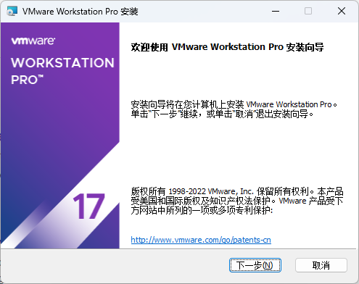
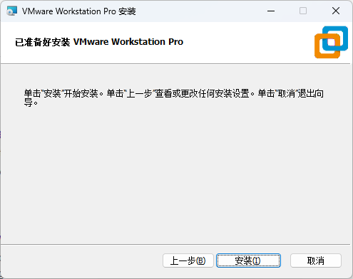
Installing VMware Workstation Pro
Just click 'Next' and click 'Next'.. And click 'Install'..

Slide 5
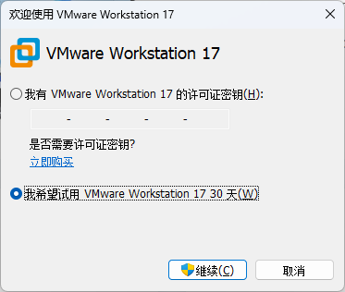
Installing VMware Workstation Pro
Choose Trial or fill in your keys

Slide 6
Setting up a Linux environment
In this tutorial, we use Ubuntu 22.04 LTS as our Linux environment's operating system.
We need to download the install image first.
Link to get install image: https://ubuntu.com/download/desktop
For macOS with Apple silicon, use PD18 and this link: https://cdimage.ubuntu.com/jammy/daily-live/current/jammy-desktop-arm64.iso

Slide 7
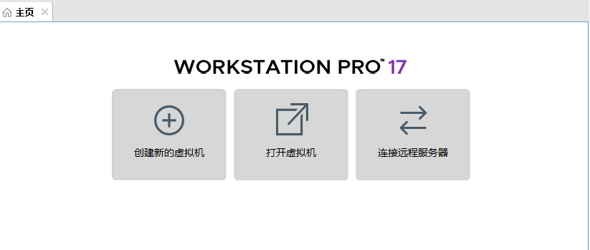
Setting up a Linux environment
Then we turn back to VMware Workstation.
Click 'Create new virtual machine'.

Slide 8
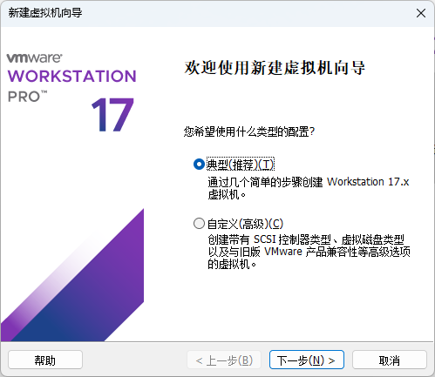
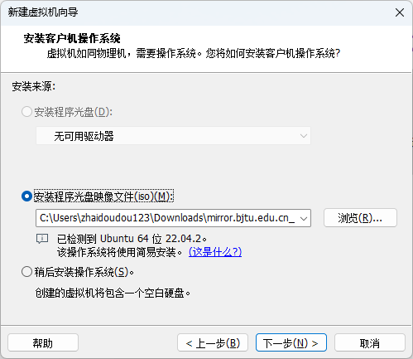
Setting up a Linux environment
Continue configurating and choose the install image.

Slide 9
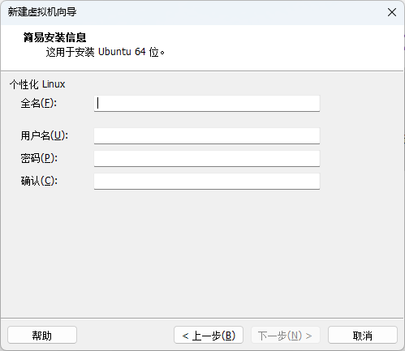
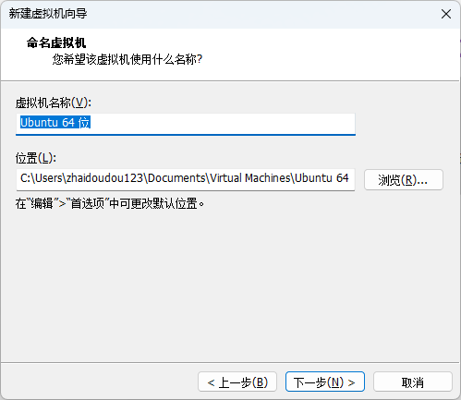
Setting up a Linux environment
Configure username and password and virtual machine's name:

Slide 10
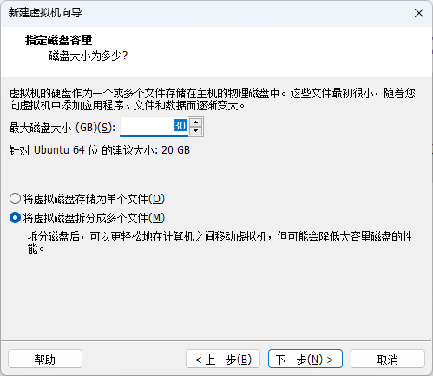
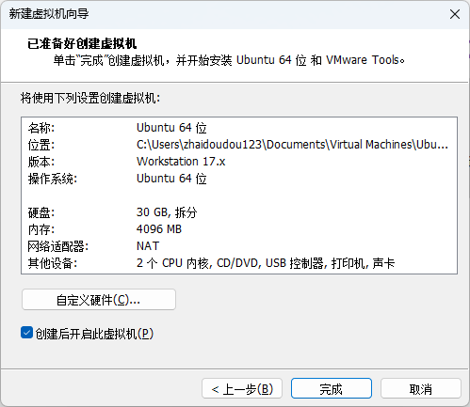
Setting up a Linux environment
Configure disk size; 30GB is enough and can be added later.
We can customize memory, NICs and other virtual devices later.

Slide 11
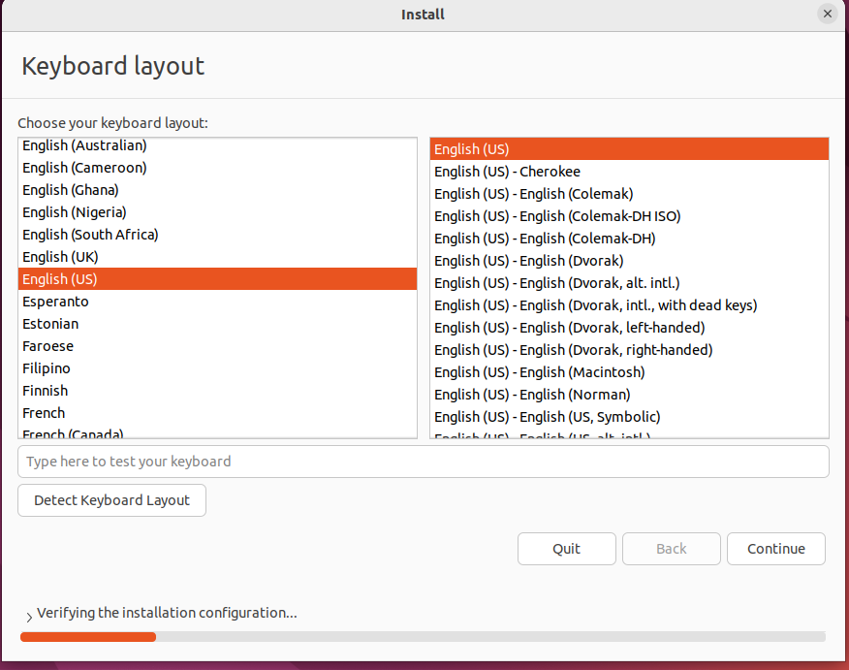
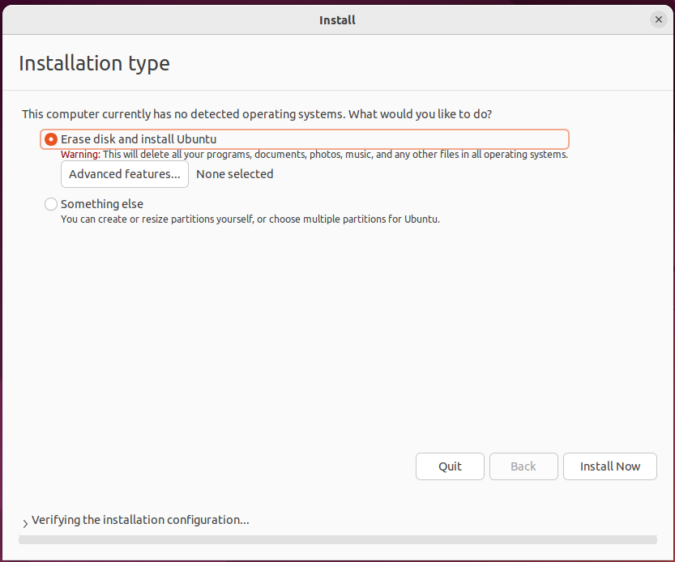
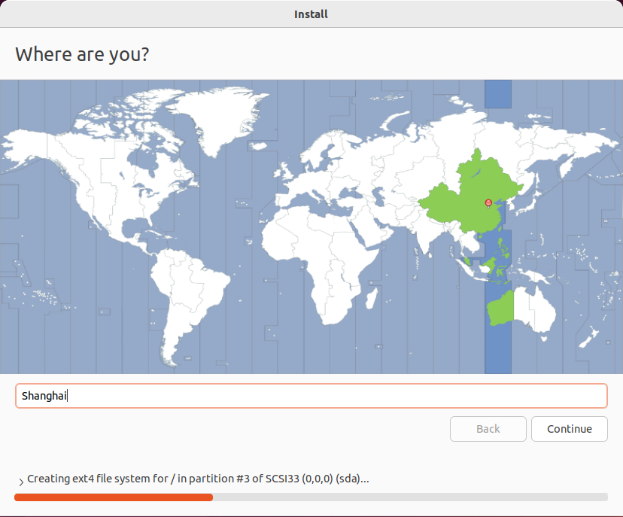
Setting up a Linux environment
Choose English(US) as the keyboard layout and just continue.
Choose Shanghai as the time zone.
Maybe we need to set username and password again.

Slide 12
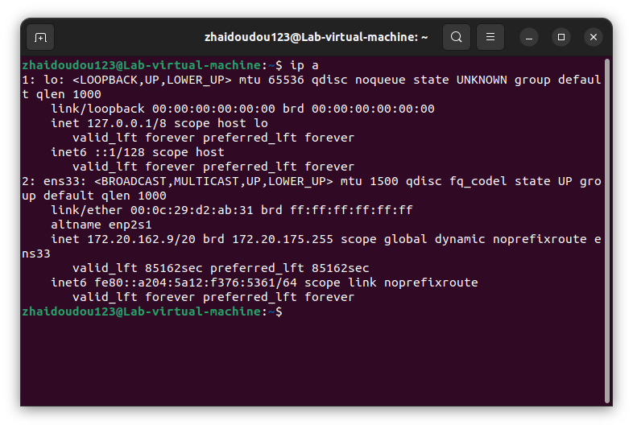
Setting up a Linux environment
Open 'terminal' in Ubuntu and input ip a to get IP address of the VM.

Slide 13
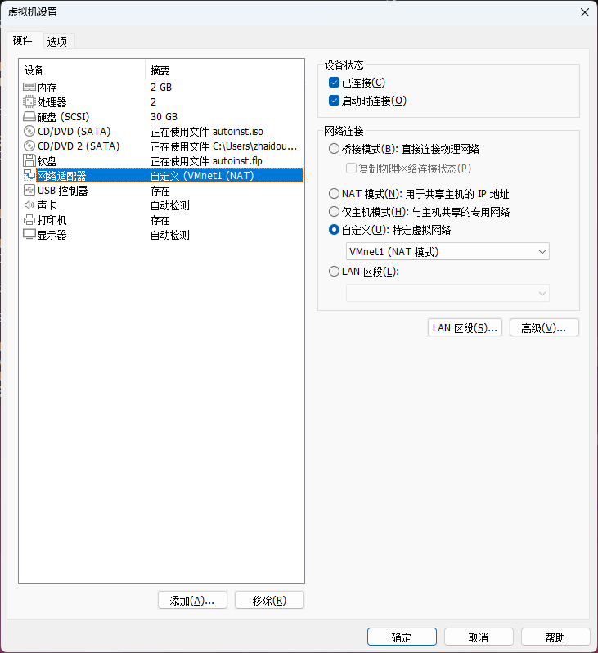
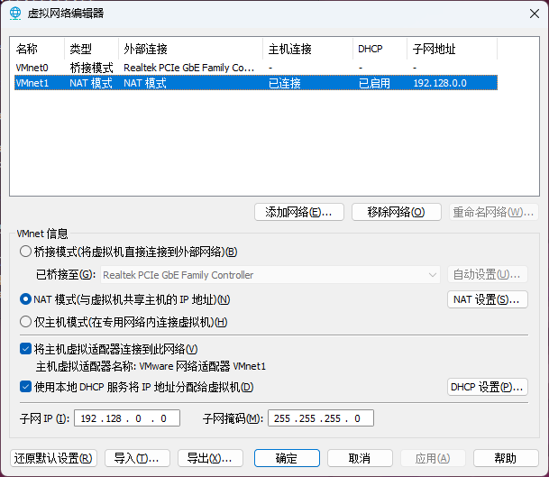
Setting up a Linux environment
Notes:
编辑-虚拟网络编辑器

Slide 14
Setting up a Linux environment
Input sudo apt-get update first.
Continue with sudo apt-get install openssh-server to install SSH server. Use sudo apt-get install open-vm-tools open-vm-tools-desktop open-vm-tools-dkms to install VMware tools.
Return to your host PC, connect to the IP with your username and password using your favorite SSH terminal, such as Termius, or Windows built-in SSH command from Windows Terminal: ssh username@ipaddresss

Slide 15
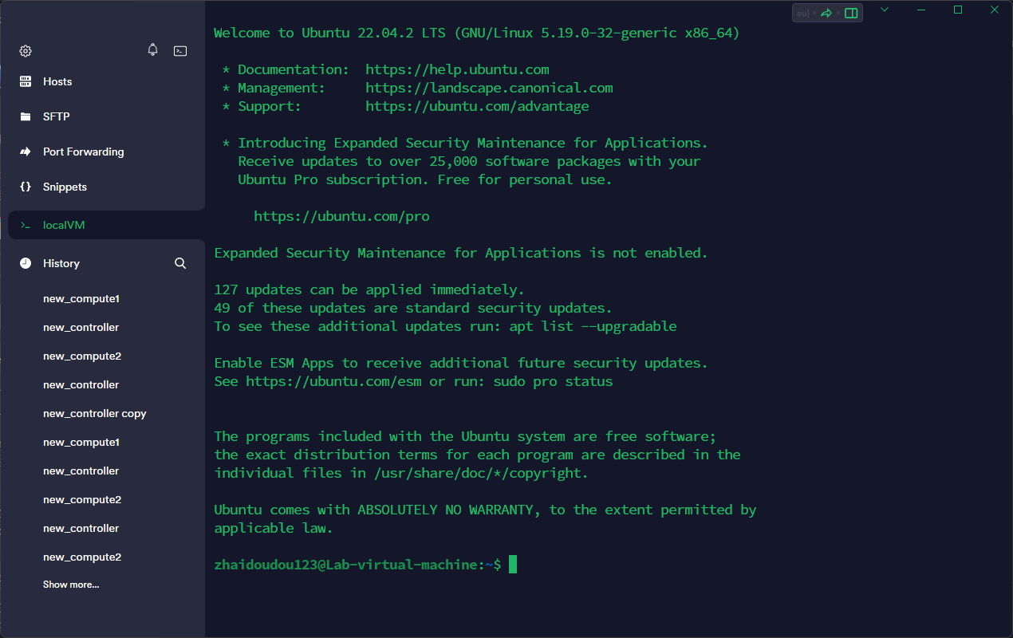
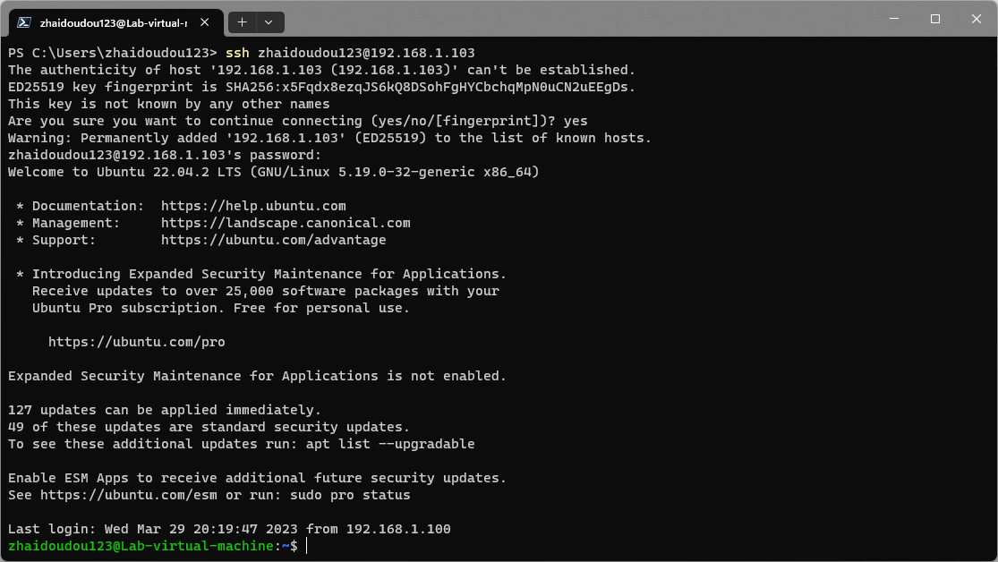
Setting up a Linux environment
Link to download termius: https://termius.com/

Slide 16
Setting up a Linux environment
Use command sudo apt-get install build-essential linux-headers-`uname -r` to install essential packages for kernel development.
Now, we finally get our own Linux environment for kernel module development!

Slide 17



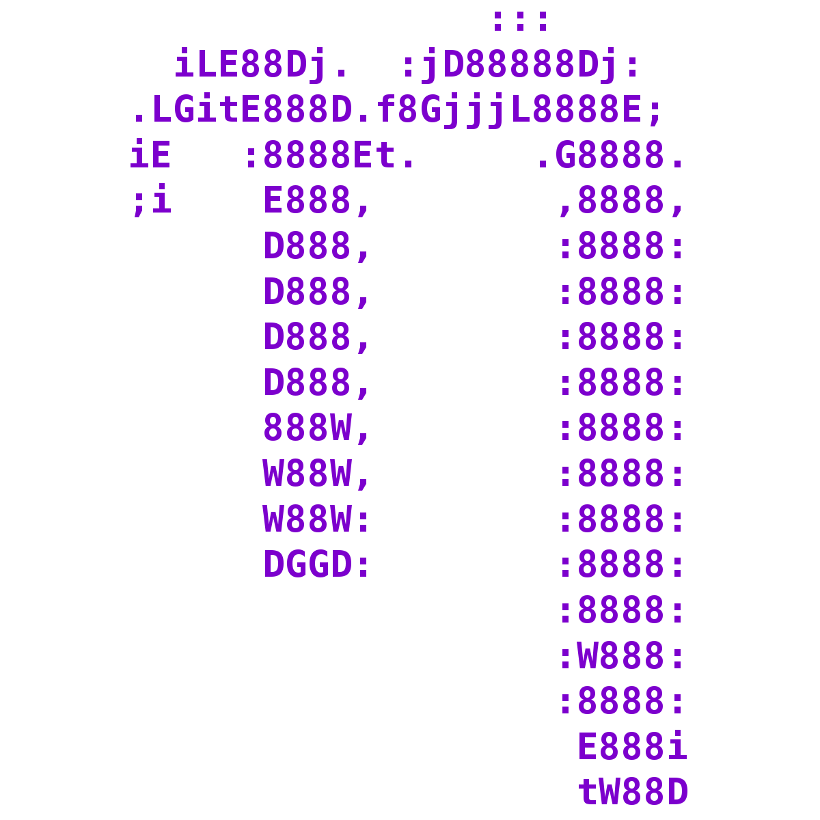

Choose editor
Choose your favorite editor or IDE first.
I prefer using Visual Studio Code for remote development, but you can also use Ubuntu built-in editor VIM and nano, or IDE like CLion or Visual Studio.
Useful links: VSCode: https://zhuanlan.zhihu.com/p/141205262 VIM: https://www.runoob.com/linux/linux-vim.html nano: https://cloud.tencent.com/developer/article/1187038
All are okay!

Slide 18

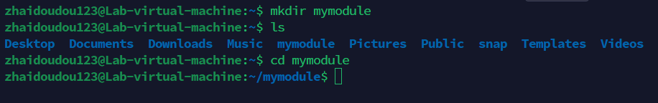
Basic Linux command and VIM tutorial
After connecting to the VM using SSH, you are now in your user's home folder.
Use mkdir mymodule to make your folder for the kernel module.
Use ls to list all the files and folders.
Use cd mymodule to change to your folder.

Slide 19
Basic Linux command and VIM tutorial
If you decide to use VIM, follow the instructions below.
Use the following command to install full version of VIM in Ubuntu. sudo apt-get remove vim-common sudo apt-get install vim
Use vi mymodule.c to create a new C file.
Type 'I' or click Insert button to change to insert mode.
Input some simple code such as a hello world demo.

Slide 20
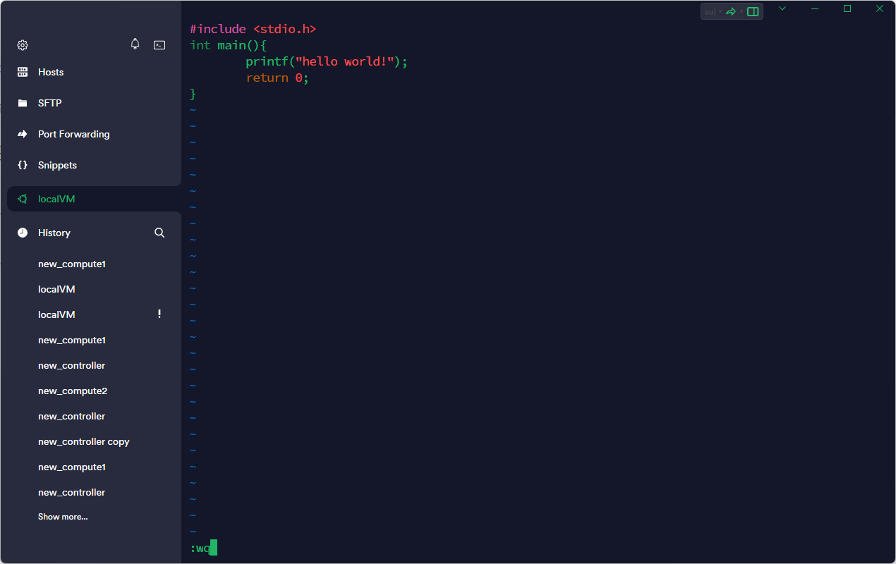
Basic Linux command and VIM tutorial
Click ESC button to change to command mode.
Type ':wq' to save file.
Hint: ':q!' to just quit without saving.

Slide 21
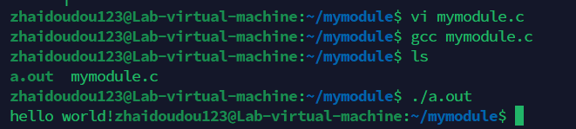
Basic Linux command and VIM tutorial
Compile using gcc mymodule.c and run it.
In next slides, I will not mention editor and explain basic Linux command to save time.

Slide 22
Coding

Slide 23
A simple kernel module
Finally, we come to coding.
Let's start with a simple 'Hello world' module.

Slide 24
A simple kernel module
helloworld.c
#include <linux/init.h>
#include <linux/module.h>
#include <linux/kernel.h>
MODULE_LICENSE("GPL");
MODULE_AUTHOR("Yi");
MODULE_DESCRIPTION("A simple hello world module.");
MODULE_VERSION("0.01");
static int __init hello_world_init(void) {
printk(KERN_INFO "Hello, World!\n");
return 0;
}
static void __exit hello_world_exit(void) {
printk(KERN_INFO "Goodbye, World!\n");
}
module_init(hello_world_init);
module_exit(hello_world_exit);

Slide 25
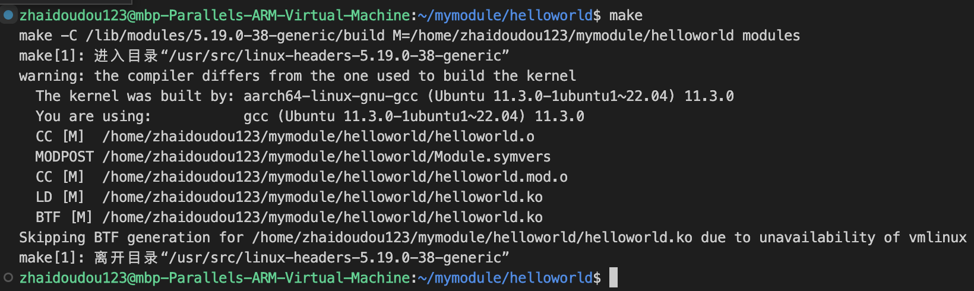
A simple kernel module
Makefile
Use command make to compile the kernel module:
obj-m += helloworld.o
all:
make -C /lib/modules/$(shell uname -r)/build M=$(PWD) modules
clean:
make -C /lib/modules/$(shell uname -r)/build M=$(PWD) clean
Notes:
obj-m+=hello.o
obj-m表示编译生成可加载模块。
相对应的，obj-y表示直接将模块编译进内核。
可以看到，这里并没有输入helloworld.c源文件，这得益于makefile的自动推导功能，需要编译生成filename.o文件而没有显示地指定filename.c文件位置时，make查找filename.c是否存在，如果存在就正常编译，如果不存在，则报错。
obj-m+=hello.o，这条语句就是显式地将hello.o编译成hello.ko,而hello.o则由make的自动推导功能编译hello.c文件生成。
all，clean
all，clean这一类的是makefile中的伪目标，伪目标并不是一个真正的编译目标，它代表着一系列你想要执行的命令集合，通常一个makefile会对应多个操作，例如编译，清除编译结果，安装，就可以使用这些伪目标来进行标记。在执行时就可以键入：
make clean make install 等指令来完成相应的指令操作，当make后不带参数时，默认执行第一个伪目标的操作。
make -C $KDIR M=$PWD [target]
标准的make指令是这样的：make -C $KDIR M=$PWD [target]，下面分别介绍每个字段的含义。
-C选项：此选项指定内核源码的位置，make在编译时将会进入内核源码目录，执行编译，编译完成时返回。
$KDIR：/lib/modules/$(shell uname -r)/build/，指定内核源码的位置。
直接在目标板上编译时，内核头文件默认存放在/lib/modules/$(shell uname -r)/build/中，这个build/目录是一个软连接，链接到源码头文件的安装位置。而内核真正的源码库则直接引用正在运行的内核镜像。
当跨平台编译时，就需要指定相应的内核源码目录，而不是系统中的源码目录，但是交叉编译时，需不需要指定架构平台和交叉编译工具链呢？我们接着往下看;
M=$(PWD)：需要编译的模块源文件地址
[target]：modules，事实上，这是个可选选项。默认行为是将源文件编译并生成内核模块，即module(s)，但是它还支持一下选项：
modules_install:安装这个外部模块，默认安装地址是/lib/modules/$(uname -r)/extra/，同时可以由内建变量INSTALL_MOD_PATH指定安装目录
clean:卸载源文件目录下编译过程生成的文件，在上文的makefile最后一行可以看到。
help：帮助信息

Slide 26
A simple kernel module
-C: 指定内核头文件位置 M：指定需要编译的模块位置 $(PWD) ：当前目录
[target] 指定编译行为，modules：生成内核模块 clean：删除生成过程中文件
Makefile
Use command make to compile the kernel module:
make -C $KDIR M=$PWD [target]
obj-m += helloworld.o
all:
make -C /lib/modules/$(shell uname -r)/build M=$(PWD) modules
clean:
make -C /lib/modules/$(shell uname -r)/build M=$(PWD) clean
Notes:
obj-m+=hello.o
obj-m表示编译生成可加载模块。
相对应的，obj-y表示直接将模块编译进内核。
可以看到，这里并没有输入helloworld.c源文件，这得益于makefile的自动推导功能，需要编译生成filename.o文件而没有显示地指定filename.c文件位置时，make查找filename.c是否存在，如果存在就正常编译，如果不存在，则报错。
obj-m+=hello.o，这条语句就是显式地将hello.o编译成hello.ko,而hello.o则由make的自动推导功能编译hello.c文件生成。
all，clean
all，clean这一类的是makefile中的伪目标，伪目标并不是一个真正的编译目标，它代表着一系列你想要执行的命令集合，通常一个makefile会对应多个操作，例如编译，清除编译结果，安装，就可以使用这些伪目标来进行标记。在执行时就可以键入：
make clean make install 等指令来完成相应的指令操作，当make后不带参数时，默认执行第一个伪目标的操作。
make -C $KDIR M=$PWD [target]
标准的make指令是这样的：make -C $KDIR M=$PWD [target]，下面分别介绍每个字段的含义。
-C选项：此选项指定内核源码的位置，make在编译时将会进入内核源码目录，执行编译，编译完成时返回。
$KDIR：/lib/modules/$(shell uname -r)/build/，指定内核源码的位置。
直接在目标板上编译时，内核头文件默认存放在/lib/modules/$(shell uname -r)/build/中，这个build/目录是一个软连接，链接到源码头文件的安装位置。而内核真正的源码库则直接引用正在运行的内核镜像。
当跨平台编译时，就需要指定相应的内核源码目录，而不是系统中的源码目录，但是交叉编译时，需不需要指定架构平台和交叉编译工具链呢？我们接着往下看;
M=$(PWD)：需要编译的模块源文件地址
[target]：modules，事实上，这是个可选选项。默认行为是将源文件编译并生成内核模块，即module(s)，但是它还支持一下选项：
modules_install:安装这个外部模块，默认安装地址是/lib/modules/$(uname -r)/extra/，同时可以由内建变量INSTALL_MOD_PATH指定安装目录
clean:卸载源文件目录下编译过程生成的文件，在上文的makefile最后一行可以看到。
help：帮助信息
这是由/lib/modules/$(uname -r)/build目录下的Makefile决定的，具体的比较复杂

Slide 27
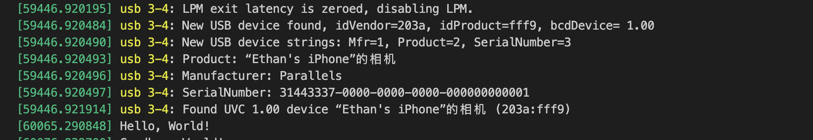
A simple kernel module
Use command sudo insmod helloworld.ko to load the module.
And use command sudo dmesg to see the output of 'printk' function.

Slide 28
A simple kernel module
Use command sudo lsmod to see all the modules loaded.
With command grep, we can see that our module is loaded: sudo lsmod | grep 'helloworld'

Slide 29
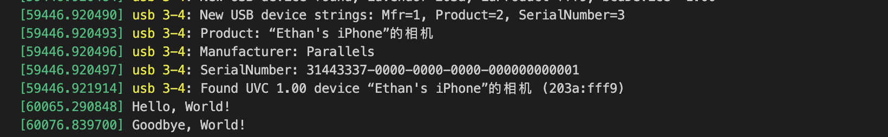
A simple kernel module
Use command sudo rmmod helloworld.ko to unload the module.
And use command sudo dmesg to see the output of 'printk' function again.
This means that our first kernel module works!

Slide 30
A netfilter kernel module
Suppose we want to build a firewall which blocks users from accessing certain websites, for example, a site with IP address 223.5.5.5.
We can do this by loading a netfilter kernel module.
Useful links: http://wiki.dreamrunner.org/public_html/Linux/Networks/netfilter.html

Slide 31
A netfilter kernel module
firewall.c
#include <linux/module.h>
#include <linux/kernel.h>
#include <linux/version.h>
#include <linux/ip.h>
#include <linux/netfilter.h>
#include <linux/netfilter_ipv4.h>
#include <linux/init.h>
MODULE_LICENSE("GPL");
MODULE_AUTHOR("Yi");
MODULE_DESCRIPTION("A firewall to drop packets.");
MODULE_VERSION("0.01");

Slide 32
A netfilter kernel module
firewall.c
unsigned int packet_filter(void *priv, struct sk_buff *skb,const struct nf_hook_state *state)
{
//ip header
struct iphdr *iph;
//If skb or ip header is null, just pass the packet.
if(skb == NULL)
return NF_ACCEPT;
//get ip hearder from kernel API ip_hdr(）
iph = ip_hdr(skb);
if(iph == NULL)
return NF_ACCEPT;
if(iph->saddr == 0x050505DF){ // 223.5.5.5's hex, Big-endian mode.
printk("drop 223.5.5.5 \n");
// drop the packet
return NF_DROP;
}
return NF_ACCEPT;
};
Notes:
We can use in_aton() in <linux/inet.h> to do this conversion

Slide 33
A netfilter kernel module
firewall.c
//define hook operations
static struct nf_hook_ops firewall_opt = {
//hook to packet_filter()
.hook = packet_filter,
//set the protocol to be ipv4 and ipv6
.pf = NFPROTO_INET,
//hook point is NF_INET_PRE_ROUTING and the priority is first
.hooknum = NF_INET_PRE_ROUTING,
.priority = NF_IP_PRI_FIRST,
};

Slide 34
A netfilter kernel module
firewall.c
static int firewall_init(void)
{
nf_register_net_hook(&init_net, &firewall_opt);
printk("[firewall] network hooks success.\n");
return 0;
};
static void firewall_exit(void)
{
//unload hook function
nf_unregister_net_hook(&init_net, &firewall_opt);
printk("[firewall] remove hook lkm success!\n");
};
module_init(firewall_init);
module_exit(firewall_exit);

Slide 35
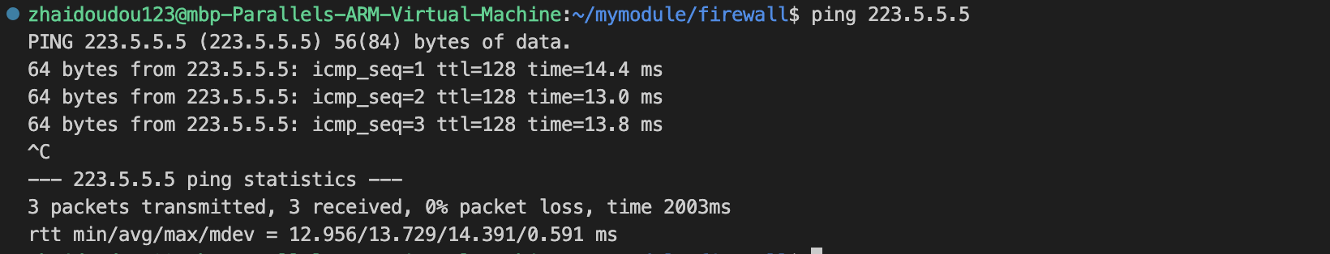
A netfilter kernel module
Makefile
Use command make to compile the kernel module.
Before loading the module, let's try ping 223.5.5.5 first.
obj-m += firewall.o
all:
make -C /lib/modules/$(shell uname -r)/build M=$(PWD) modules
clean:
make -C /lib/modules/$(shell uname -r)/build M=$(PWD) clean

Slide 36
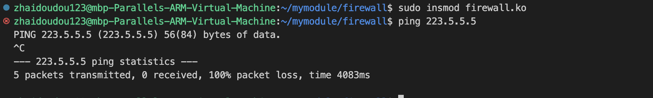
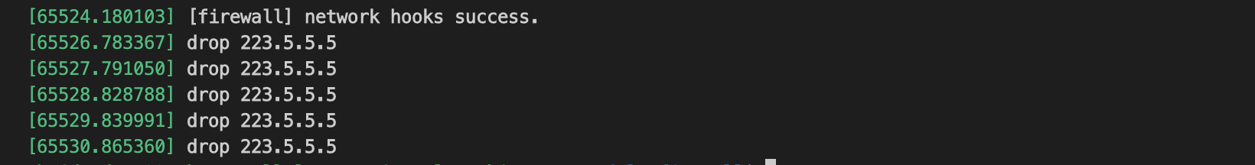
A netfilter kernel module
Use command sudo insmod firewall.ko to load the module.
Try ping 223.5.5.5 again:
Also try sudo dmesg:
Our firewall works! Remember to unload the module.

Slide 37

Review & Try
We use the netfilter sub system to build a simple firewall which drops all incoming packets from IP 223.5.5.5.
What if we want to drop outgoing packets or to drop only ICMP packets?
Try it yourself!
Tips: Hook point NF_INET_LOCAL_OUT works on outgoing packets; iph->daddr means destination IP address; struct iph has a member 'protocol', we can use it like this:
switch(iph->protocol){
case IPPROTO_ICMP:
return NF_DROP;
break;
default:
return NF_ACCEPT;
}

Slide 38
Q & A

Slide 39
Review & Try
Outgoing packets:
if(iph->daddr == 0x050505DF){ // 223.5.5.5's hex, Big-endian mode.
printk("drop 223.5.5.5 \n");
// drop the packet
return NF_DROP;
}
//define hook operations
static struct nf_hook_ops firewall_opt = {
//hook to packet_filter()
.hook = packet_filter,
//set the protocol to be ipv4 and ipv6
.pf = NFPROTO_INET,
//hook point is NF_INET_LOCAL_OUT and the priority is first
.hooknum = NF_INET_LOCAL_OUT,
.priority = NF_IP_PRI_FIRST,
};

Slide 40
Review & Try
Only ICMP packets:
if(iph->saddr == in_aton("10.211.55.2")){ // use in_aton func.
// drop the packet
switch(iph->protocol){
case IPPROTO_ICMP:
printk("drop 10.211.55.2's incoming icmp \n");
return NF_DROP;
break;
default:
return NF_ACCEPT;
}
}

Slide 41
Thanks

